Slide 1
Magnetic Field of a Current-Carrying Wire

Slide 2

Magnetic Fields Generated by Current-Carrying Wires
Welcome to this Smart Lesson about the magnetic fields generated by current-carrying wires. After you have completed this lesson you should be able to:
Determine the magnitude and direction of the magnetic field around current-carrying wires.
Draw the magnetic field generated by a current-carrying wire.
Solve problems involving the magnitude of the magnetic field, current and distance from a current-carrying wire.

Slide 3
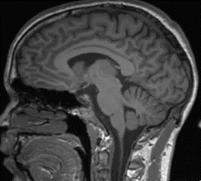
The magnetic fields generated by current-carrying wires are extremely important.
We can change the magnetic field strength generated by the wires fairly easily, which means that it can be used in important technology.
The variable magnetic fields generated by current-carrying wires are used in lots of things, from computer hard drives to MRI machines!

Slide 4
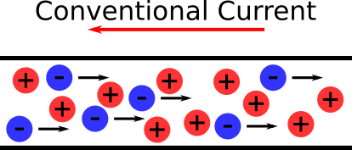
It is well known that moving, charged particles generate magnetic fields.
Wires that have a current flowing through them contain many charged particles moving in the same direction and therefore also generate magnetic fields.
The current flowing through the wire is a conventional current. This means that you need to think about it as a flow of positive charges, not a flow of electrons.

Slide 5
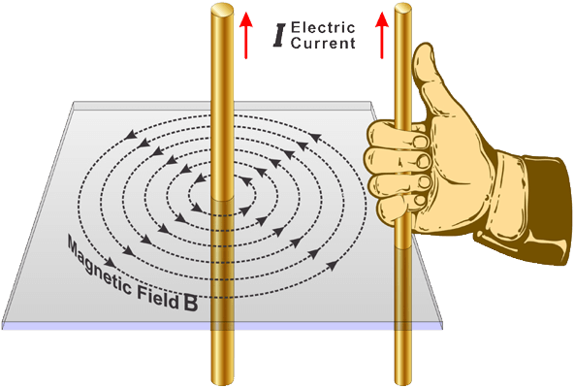
A current carrying wire produces a circular magnetic field.
The magnetic flux lines form a series of concentric circles with the wire at the center.
We can use the right-hand rule to work out the direction of the magnetic field. To do this, you hold your right hand next to the wire and point your thumb in the direction of the current. Your fingers then curl in the direction of the magnetic field.

Slide 6

The strength of a magnetic field is determined by the density of the magnetic flux lines.
Magnetic flux lines that are close together indicate a strong magnetic field while flux lines that are far apart indicate a weak magnetic field.
As we will see later in this lesson, the strength of the magnetic field generated by a current-carrying wire decreases as we move further away from the wire. In order to draw the magnetic flux lines around a current-carrying wire, we need the distance between the consecutive circles to increase as we move away from the wire.

Slide 7
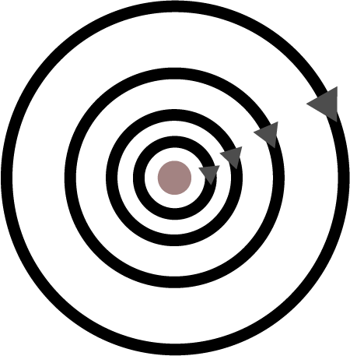
When drawing the magnetic field generated by a current-carrying wire we need to include the size and direction of the magnetic field.
The magnetic field generated around a current-carrying wire is indicated by circular magnetic flux lines, that get further apart as we move away from the wire. This is how we show the size of the magnetic field. To show the direction of the magnetic field we need to include arrows on the magnetic flux lines. The direction of the arrows can be determined by the right-hand rule and then added to the diagram.

Slide 8

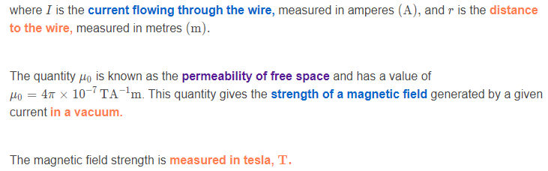
The magnetic field strength of a current-carrying wire is given by the following formula:

Slide 9

The magnetic field strength formula can tell us the relationship between the magnetic field strength, the current and the distance to the wire.
The magnetic field strength is directly proportional to the current. This means as we increase the current flowing through a wire, we also increase the strength of the generated magnetic field.
In contrast, the magnetic field strength is inversely proportional to the distance from the wire. This means as we move further away from the wire, we decrease the magnetic field strength generated by the current-carrying wire.

Slide 10
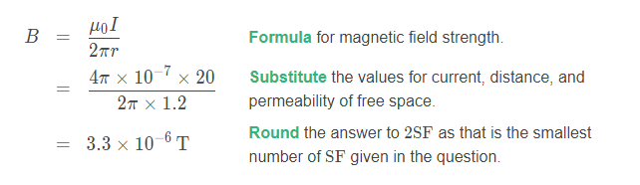

Let's work through an example using the magnetic field strength formula of a current-carrying wire.
A wire has 20A of current flowing through it. What is the magnetic field strength at a distance of 1.2m away from the wire?

Slide 11


We can rearrange the magnetic field strength formula to find either the current or the distance from the wire.
We can rearrange the formula for the magnetic field generated by a current-carrying wire to find the current flowing through the wire:
We can also rearrange the formula for the magnetic field generated by a current-carrying wire to find the distance from the wire:
Make sure you understand how to rearrange this equation for both parameters.

Slide 12
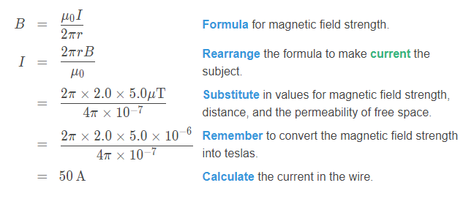
Let's work through some more examples to see how to use the rearranged formulae.
Another wire generates a magnetic field strength of 5.0μT at a distance of 2.0m away from the wire. Calculate the current in the wire.
Therefore, there is a 50A current flowing through the wire in order to generate a 5.0μT magnetic field strength at a distance of 2.0m away from the wire.

Slide 13
